Slide 1

FIND YOUR PERFECT
HAIRSTYLE
AI

Slide 2
INTRODUCTION
FINDING THE PERFECT HAIRSTYLE THAT SUITS YOUR FACE SHAPE CAN BE TRICKY. MANY PEOPLE RELY ON HAIRSTYLISTS OR TRIAL AND ERROR, OFTEN ENDING UP WITH STYLES THAT DON’T COMPLEMENT THEIR FEATURES. THIS INVENTION AIMS TO SIMPLIFY AND PERSONALIZE THE HAIRSTYLING PROCESS USING ARTIFICIAL INTELLIGENCE (AI) AND FACIAL RECOGNITION TECHNOLOGY.
THE SYSTEM WORKS BY ANALYSING A USER’S FACE THROUGH A PHOTO OR LIVE CAMERA FEED. IT IDENTIFIES KEY FACIAL FEATURES, SUCH AS JAWLINE STRUCTURE, FOREHEAD WIDTH, AND CHEEKBONE TO DETERMINE THE PERSON'S FACE SHAPE (OVAL, ROUND, SQUARE, EX). BASED ON THIS, THE SYSTEM SUGGESTS HAIRSTYLES THAT ARE MOST PERFECT FOR THAT FACE SHAPE, FROM A DIVERSE HAIRSTYLE DATABASE.

Slide 3
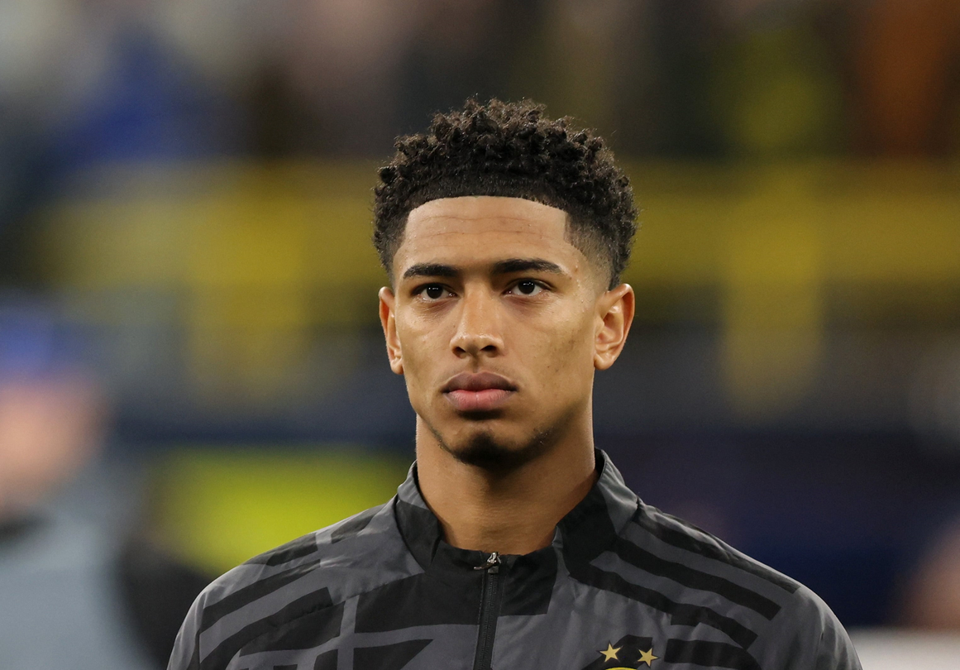
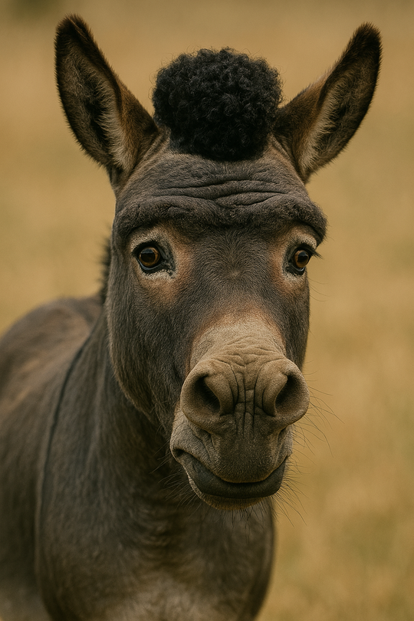
STORY TIME

Slide 4
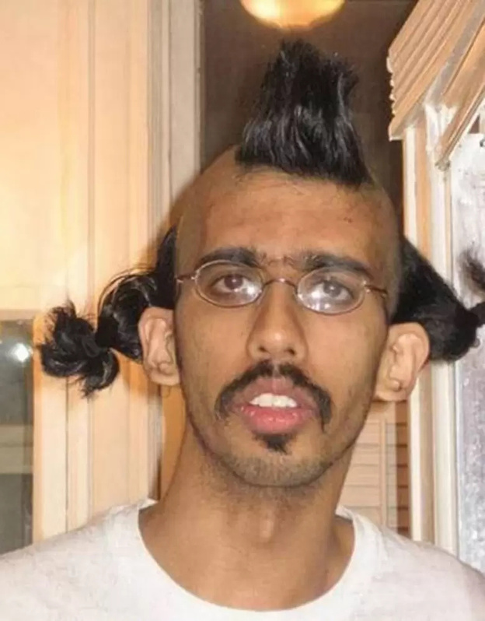

WHY THIS AI?
REAL NEED FOR PERSONALIZATION IN HAIRCARE
EVERYONE’S HAIR IS DIFFERENT—FACE SHAPE, SCALP TYPE, HAIR TEXTURE.
A GENERIC SOLUTION DOESN’T WORK. PEOPLE WANT TAILORED ADVICE.
WITHOUT PROPER HELP
THIS COULD BE U!

Slide 5
FUTURE
WHILE THERE ARE EXISTING HAIRSTYLE RECOMMENDATION TOOLS IN THE MARKET, THEY OFTEN STOP AT JUST THAT, SUGGESTING A HAIRCUT.
BUT PEOPLE DON’T WANT JUST A HAIRSTYLE; THEY WANT COMPLETE HAIR SOLUTIONS.
OUR AI IS GONNA GO BEYOND:
RECOMMENDS HAIRSTYLES BASED ON FACIAL ANALYSIS
ACCEPTS USER PROMPTS FOR ANY HAIR-RELATED CONCERNS LIKE:
HAIR FALL
DANDRUFF
DRY SCALP
STYLING DOUBTS
(JUST TYPE THE ISSUE, AND WE HANDLE THE REST)
ANALYSES THE CONCERN, GIVES ACCURATE SOLUTIONS
SUGGESTS NEARBY DOCTORS OR CLINICS BASED ON YOUR LOCATION(FUTURE UPDATE)
REAL TIME ANALYSIS AND HAIRSTYLE TRY ON(FUTURE UPDATE)

Slide 6
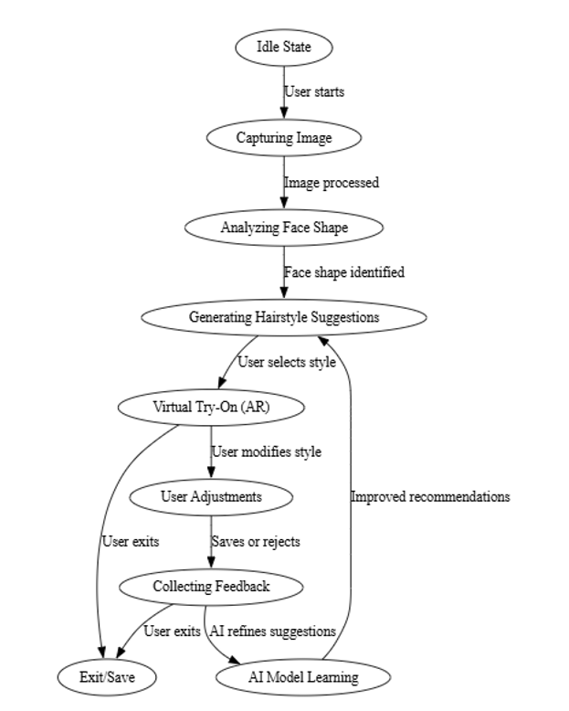
HOW DOES IT WORK?

Slide 7
APPLICATION & USER INTERFACE LAYER
THE APPLICATION LAYER PROVIDES INTERFACES FOR DIFFERENT STAKEHOLDERS, INCLUDING INDIVIDUAL USERS, SALONS, AND HAIRSTYLISTS
PERSONAL HAIRSTYLING INTERFACE
SALON & STYLIST INTERFACE
FASHION & E-COMMERCE INTEGRATION

Slide 8
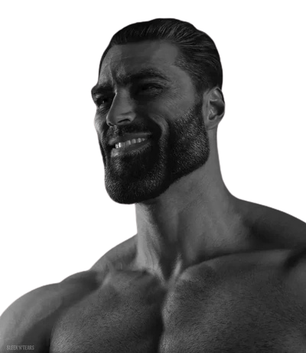
THANK YOU
THANK YOU

